Slide 1

MEERUT INSTITUTE OF ENGINEERING AND TECHNOLOGY
B.Tech Project On
Cricketer performance analysis
Presented By :
Supervised By:
Tushar Goel(2100681540052)
Mr. Hemant Baranwal
Vaibhav Gupta(2100681540053)
Department of CSE -DS
Kartavya Tyagi(2100681540025)

Slide 2

Cricket Players Analysis Data Science Project
Explore the power of data science in understanding and enhancing cricket player performance. This project delves into the intricate details of player statistics, uncovering insights that can drive strategic decision-making and improve the game.
By Kartavya Tyagi(2100681540025)
Tushar Goel(2100681540052)
Vaibhav Gupta(2100681540053)

Slide 3
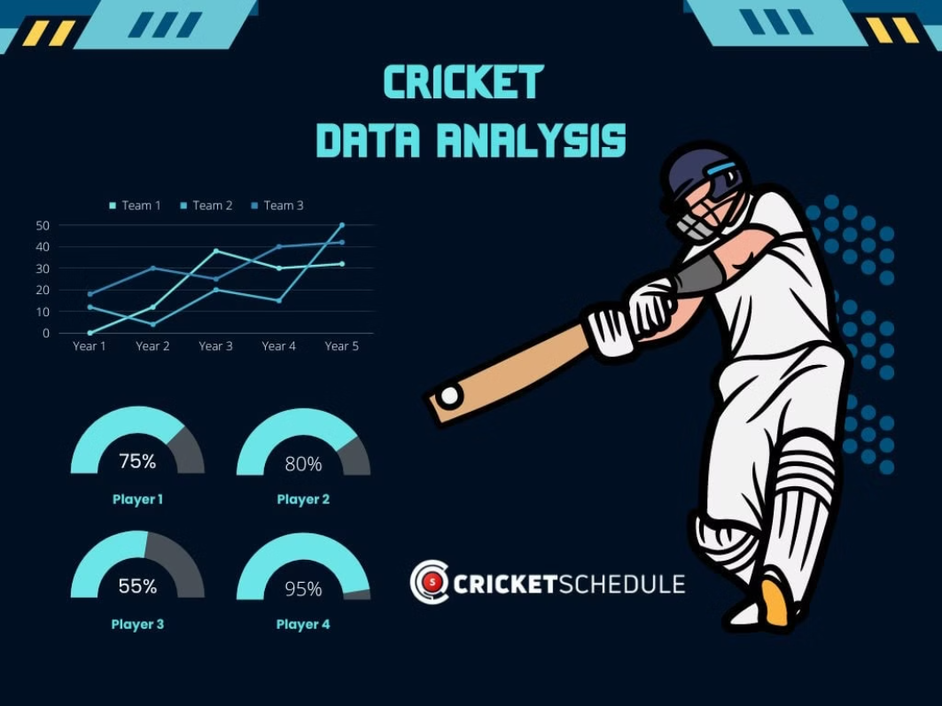

Slide 4

Project Objectives and Scope
Develop a comprehensive player performance analysis system to identify key factors that contribute to cricket success.
Leverage advanced data science techniques to uncover hidden patterns and insights from vast player statistics.
Provide actionable recommendations to coaches, team management, and talent scouts to enhance player development and team strategies.

Slide 5
Data Collection and Preprocessing
Gathering the necessary data is crucial for our cricket players analysis project. We'll source player statistics, match records, and contextual information from reliable sports databases and online repositories. Robust data preprocessing techniques will ensure the data is clean, standardized, and ready for in-depth analysis.

Slide 6
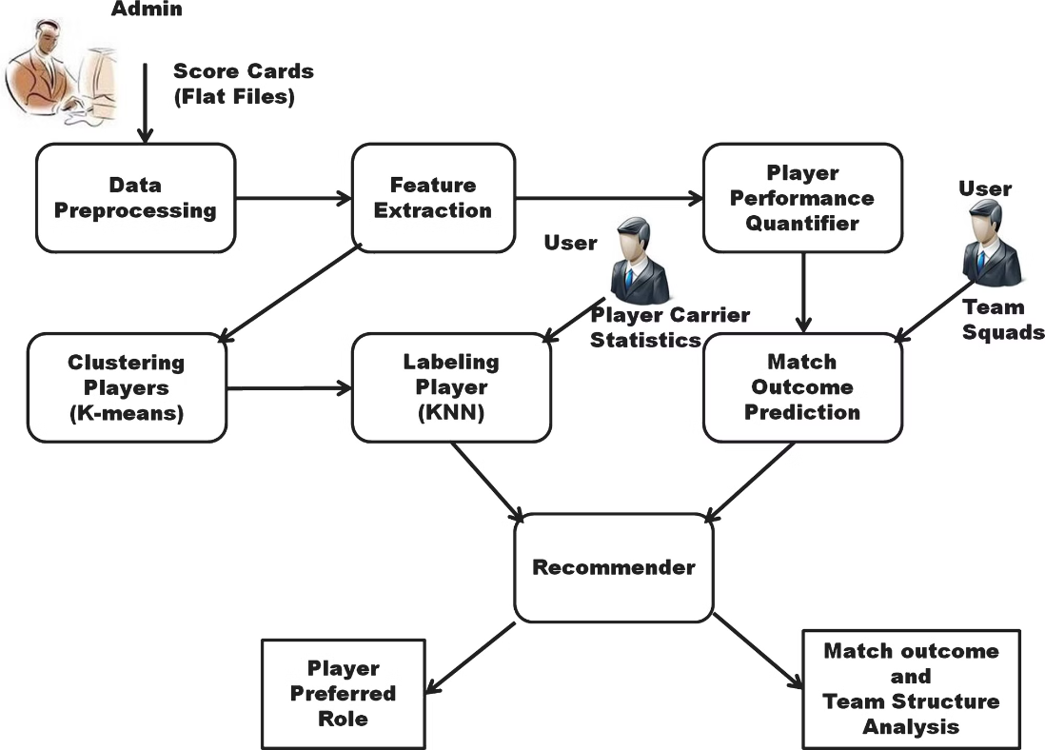

Slide 7
Exploratory Data Analysis
Delving into the vast landscape of cricket player data, we'll embark on an exploratory journey to uncover hidden patterns, identify key performance indicators, and gain valuable insights that will shape our path forward.
Using advanced data visualization techniques, we'll paint a vibrant picture of player statistics, uncovering the subtle nuances that separate the champions from the rest.

Slide 8
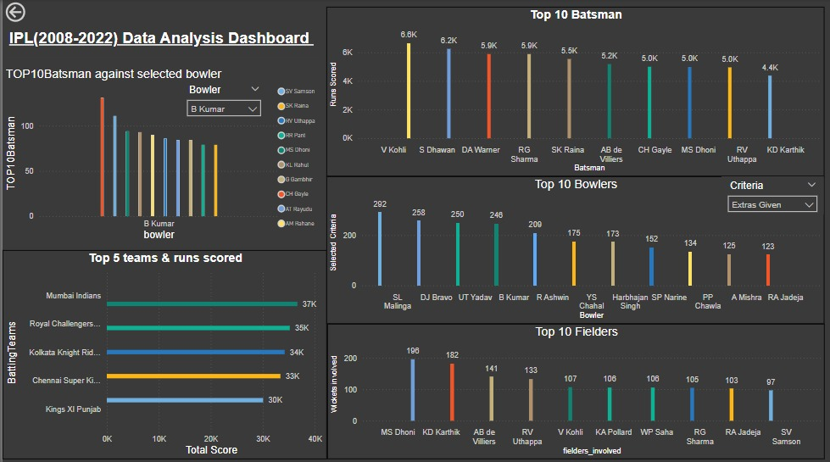
Player Performance

Slide 9
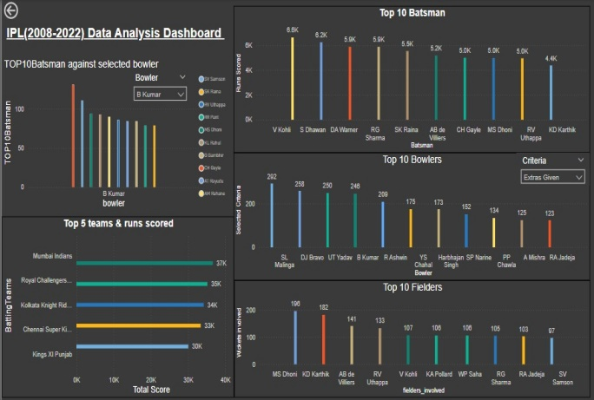

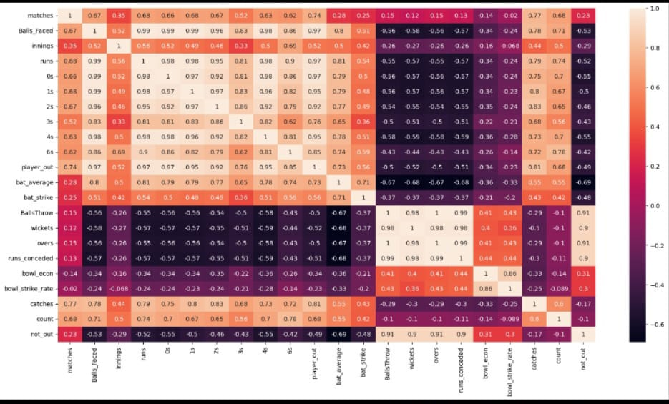
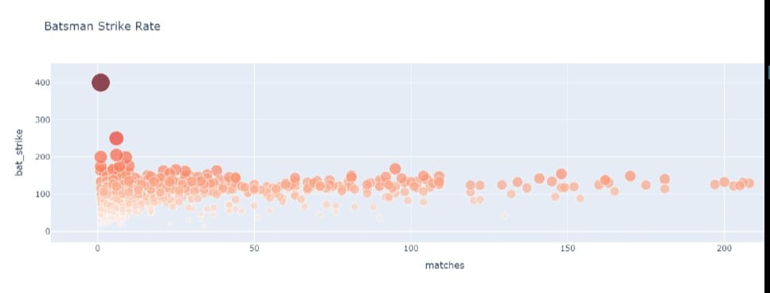
Insights and Visualization
Comprehensive Dashboard
Heatmap Analysis
Scatter Plot Insights
Detailed heatmaps uncover players' scoring zones, bowling patterns, and fielding coverage, enabling targeted strategy development and skill improvement.
Intuitive dashboards combine player statistics, performance trends, and predictive insights to empower coaches and analysts with a holistic view of team dynamics.
Scatter plots reveal correlations between player attributes, highlighting unexpected relationships and guiding roster decisions and training priorities.

Slide 10
Feature Engineering and Selection
To extract maximum value from our cricket player data, we'll employ advanced feature engineering techniques. We'll create new predictive variables by combining and transforming the raw statistics, uncovering hidden insights that could drive model performance.
Rigorous feature selection will then identify the most impactful attributes, enabling us to build streamlined, high-accuracy models that can truly elevate player and team performance.

Slide 11
Performance Evaluation and Validation
Rigorous Testing
We'll subject our cricket player analysis models to a rigorous testing regime, evaluating their performance on hold-out datasets to ensure robust and unbiased predictions.
Metric Selection
Carefully selecting the right performance metrics, such as accuracy, F1-score, and area under the ROC curve, will help us objectively assess the models' predictive power.
1
2
3
Cross-Validation
Using advanced cross-validation techniques, we'll assess the stability and generalizability of our models, identifying any potential sources of overfitting or bias.

Slide 12
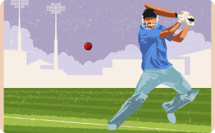
Visualization and Attractive Animation Effects
Data Visualization
Animated Insights
Performance Metrics
Unlock the power of interactive, visually stunning data visualizations to uncover captivating insights from the cricket player data. Dashboards and infographics will bring the numbers to life, enabling stakeholders to make informed decisions.
Leverage the latest data visualization techniques, including mesmerizing animations, to dynamically showcase the complex patterns and trends within the cricket player data. These vibrant displays will engage and captivate your audience, making the insights truly unforgettable.
Crafting eye-catching visualizations of key performance indicators, such as batting averages, bowling strike rates, and fielding efficiencies, will empower coaches, managers, and scouts to make data-driven decisions that elevate their teams to new heights.

Slide 13
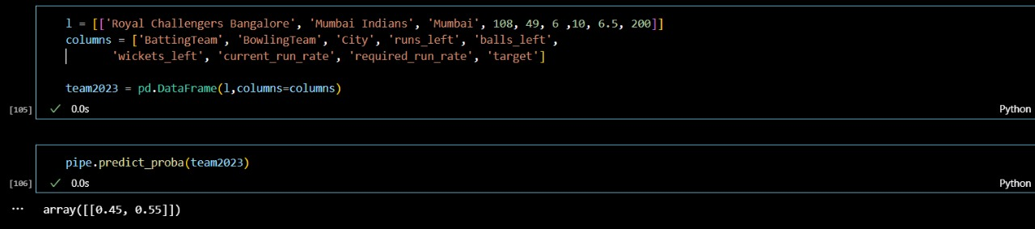
INTERACTIVE MACHINE LEARNING MODEL
IPL WINNING PREDICTION
K-means clustering is a popular unsupervised machine learning technique that can be used to group similar IPL teams based on their performance metrics. By analyzing historical data such as runs scored, wickets taken, net run rate, and other relevant factors, the algorithm can identify distinct clusters of teams with similar playing styles and performance levels. This clustering information can then be used to make informed predictions about potential IPL winners by identifying teams that consistently belong to high-performing clusters.

Slide 14
Insights and Recommendations
Identify Top Performing Players
Optimize Training Programs
Our analysis revealed standout cricketers with exceptional batting, bowling, and fielding stats. Leveraging these insights can help curate a powerhouse team and develop a winning strategy.
By understanding the key factors that drive player performance, we can design tailored training regimens to address individual strengths and weaknesses, elevating the overall skill level of the team.
Uncover Untapped Talent
Enhance Strategic Decision-Making
Our data-driven approach uncovered promising young cricketers with the potential to become future stars. Investing in their development can replenish the talent pipeline and ensure long-term success.
The insights generated from this project can empower coaches and team managers to make more informed decisions regarding player selection, team composition, and in-game tactics, ultimately leading to improved on-field performance.

Slide 15
Conclusion and Future Enhancements
Impactful Insights
Ongoing Refinement
Expanded Capabilities
Collaborative Approach
Through this comprehensive data science project, we have uncovered a wealth of insights that can revolutionize the way cricket teams approach player development and strategic decision-making.
As the sport of cricket continues to evolve, we are committed to regularly updating our analysis models and incorporating new data sources to ensure our recommendations remain cutting-edge and highly relevant.
Future enhancements to the project may include integrating player biometrics, incorporating real-time in-game data, and expanding the analysis to cover international cricket leagues and tournaments.
We envision this cricket players analysis project as a collaborative effort, working closely with coaches, scouts, and team management to continuously refine the system and maximize its impact on the sport.

Slide 16


Introduction to Data Analysis Tools
Explore a suite of powerful tools that enable you to unlock insights from data. From spreadsheets to programming languages, these versatile applications provide the foundation for effective data analysis and decision-making.

Slide 17
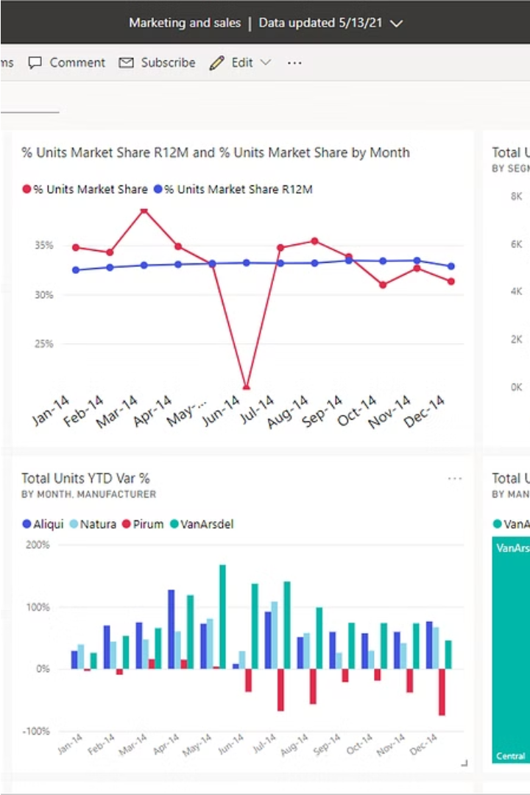
Power BI: Data Visualization and Reporting
Power BI is a powerful data visualization and reporting tool that enables businesses to transform raw data into insightful, interactive dashboards. Leveraging a user-friendly interface, Power BI empowers users to create stunning visual reports, analyze trends, and make data-driven decisions with ease.

Slide 18
SQL: Querying and Manipulating Data
1
Data Retrieval
SQL's SELECT statement allows you to query and extract specific data from databases, enabling data-driven decision making.
2
Data Transformation
SQL offers a variety of functions and clauses to manipulate data, such as filtering, sorting, grouping, and joining tables.
3
Database Management
SQL provides the ability to create, modify, and manage database structures, ensuring data integrity and accessibility.

Slide 19
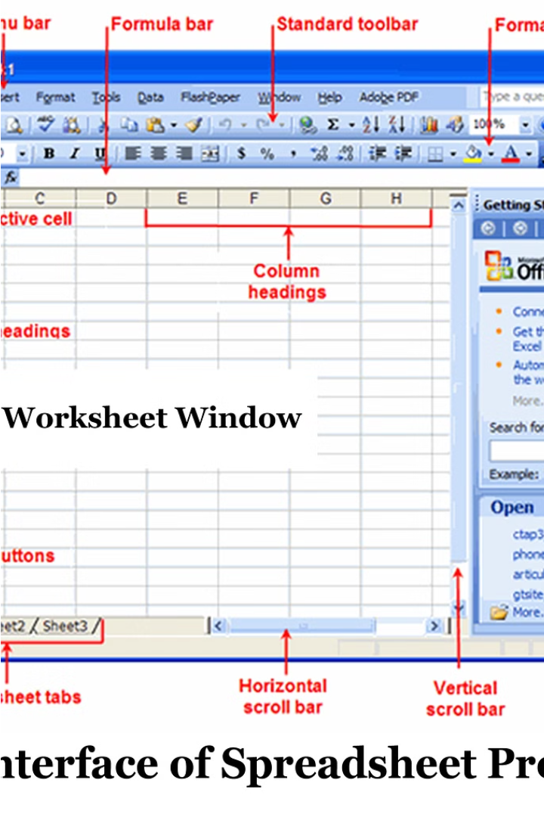
Excel: Spreadsheet Fundamentals
Excel is a versatile spreadsheet application that empowers users to organize, analyze, and visualize data. With a user-friendly interface and powerful computation capabilities, Excel enables data-driven decision making across industries.

Slide 20

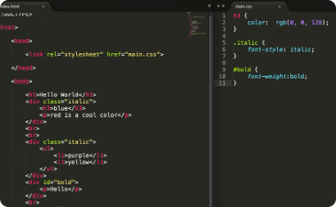
HTML, CSS: Web Development
HTML: Structuring Web Pages
CSS: Styling Web Elements
HTML, the backbone of web development, provides the structure and content for web pages, defining the elements that make up the user interface.
CSS, the language of design, allows developers to control the visual presentation of web content, from colors and fonts to layouts and animations.

Slide 21
Python: A Versatile Programming Language
Powerful and Flexible
General-Purpose
Python is a highly versatile programming language known for its simplicity, readability, and extensive library ecosystem, making it a popular choice for a wide range of applications.
From web development and data analysis to artificial intelligence and automation, Python's broad capabilities allow developers to tackle a diverse array of challenges.
Rapid Prototyping
Thriving Community
Python's concise syntax and dynamic typing enable developers to quickly create and iterate on ideas, accelerating the development process.
Python boasts a large and active community of developers, providing a wealth of open-source libraries, tools, and resources to support developers at all skill levels.

Slide 22
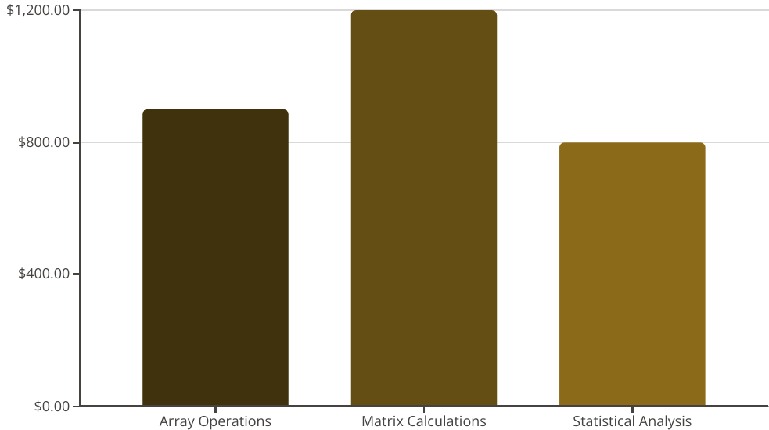
NumPy: Numerical Computing in Python
NumPy is a powerful open-source Python library that provides support for large, multi-dimensional arrays and matrices. It excels at performing efficient numerical operations, making it an essential tool for data-intensive scientific and engineering applications.
With its comprehensive collection of high-level mathematical functions, NumPy simplifies the implementation of algorithms involving arrays and matrices, allowing developers to focus on problem-solving rather than low-level data manipulation.

Slide 23
Pandas: Data Manipulation and Analysis
Flexible Data Structures
Data Cleaning and Preprocessing
Advanced Analytics
Efficient Data I/O
Pandas provides two primary data structures, Series and DataFrame, which offer powerful tools for working with tabular, multidimensional, potentially heterogeneous data.
Pandas integrates seamlessly with other Python libraries, enabling users to perform complex statistical analyses, data visualizations, and machine learning workflows.
Pandas supports a wide range of data file formats, making it easy to read, write, and exchange data between different systems and applications.
Pandas excels at handling missing values, transforming data formats, and performing data cleaning tasks that are essential for preparing data for analysis.

Slide 24

GOOGLE DATA STUDIO
Google Data Studio, now rebranded as Looker Studio, is a powerful and intuitive data visualization tool that empowers you to transform raw data into insightful and engaging reports and dashboards. With its user-friendly interface and extensive data source compatibility, you can easily connect to various data sources, including Google Analytics, Google Ads, Big Query, and more. Looker Studio offers a wide range of customizable charts, graphs, and tables to visualize your data in a visually appealing way. You can tailor your reports to specific audiences by adding filters, drill-down capabilities, and interactive elements. Whether you're a marketer, analyst, or business leader, Looker Studio can help you make data-driven decisions, track key performance indicators, and communicate complex insights effectively.

Slide 25
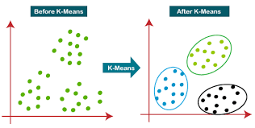
k – MEANS CLUSTERING
K-means clustering is a popular unsupervised machine learning algorithm used to group similar data points together. It aims to partition a dataset into a pre-defined number of clusters (k), where data points within each cluster are similar and dissimilar to points in other clusters. The algorithm iteratively assigns data points to the nearest cluster center (centroid) and then recalculates the centroids based on the new assignments. This process continues until the cluster assignments stabilize.

Slide 26
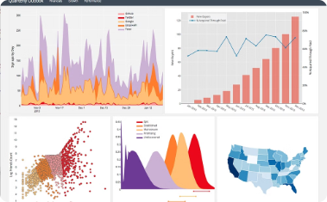
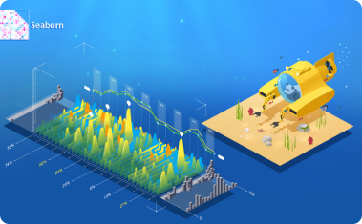
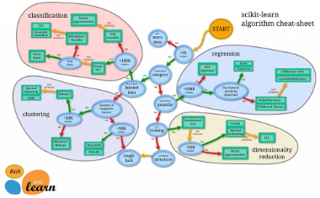
Matplotlib, Seaborn, and Scikit-Learn: Data Visualization and Machine Learning
Matplotlib: Powerful Plotting
Seaborn: Elegant Statistical Graphics
Scikit-Learn: Machine Learning Simplified
Matplotlib is a comprehensive library for creating static, animated, and interactive visualizations in Python. It offers a wide range of plot types and customization options to bring data to life.
Seaborn is a high-level data visualization library built on top of Matplotlib. It provides a concise and expressive syntax for creating attractive and informative statistical graphics.
Scikit-Learn is a robust and user-friendly machine learning library that provides simple and efficient tools for data mining and data analysis. It seamlessly integrates with the Numpy and Scipy ecosystem.

Slide 27
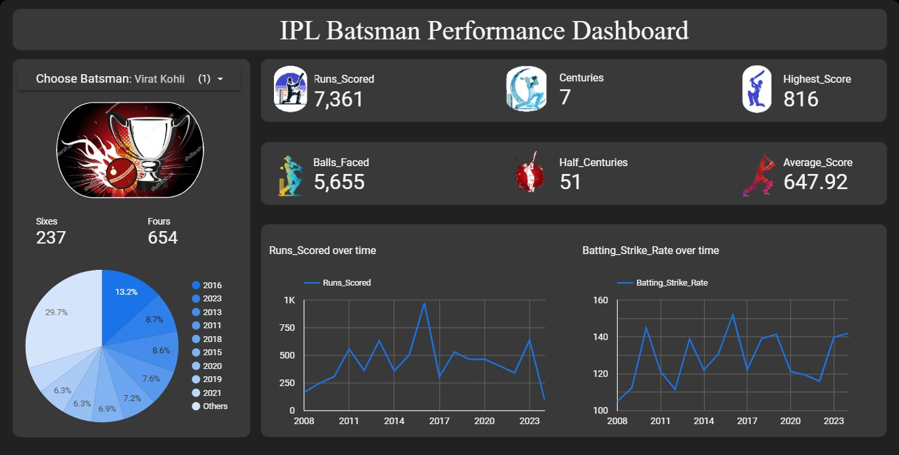
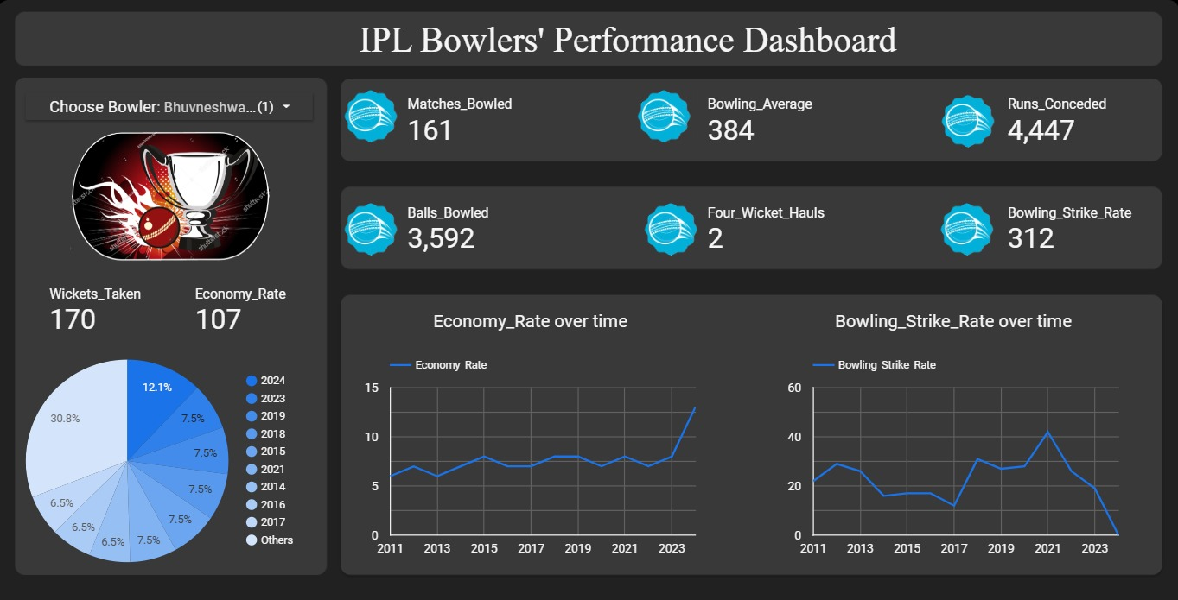
Output Screens

Slide 28
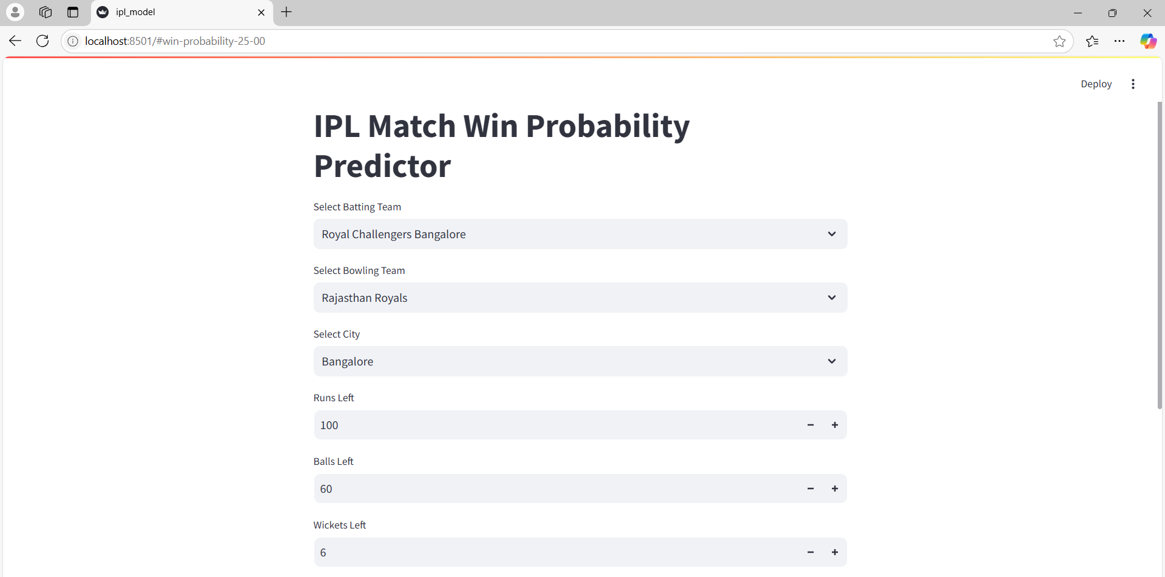
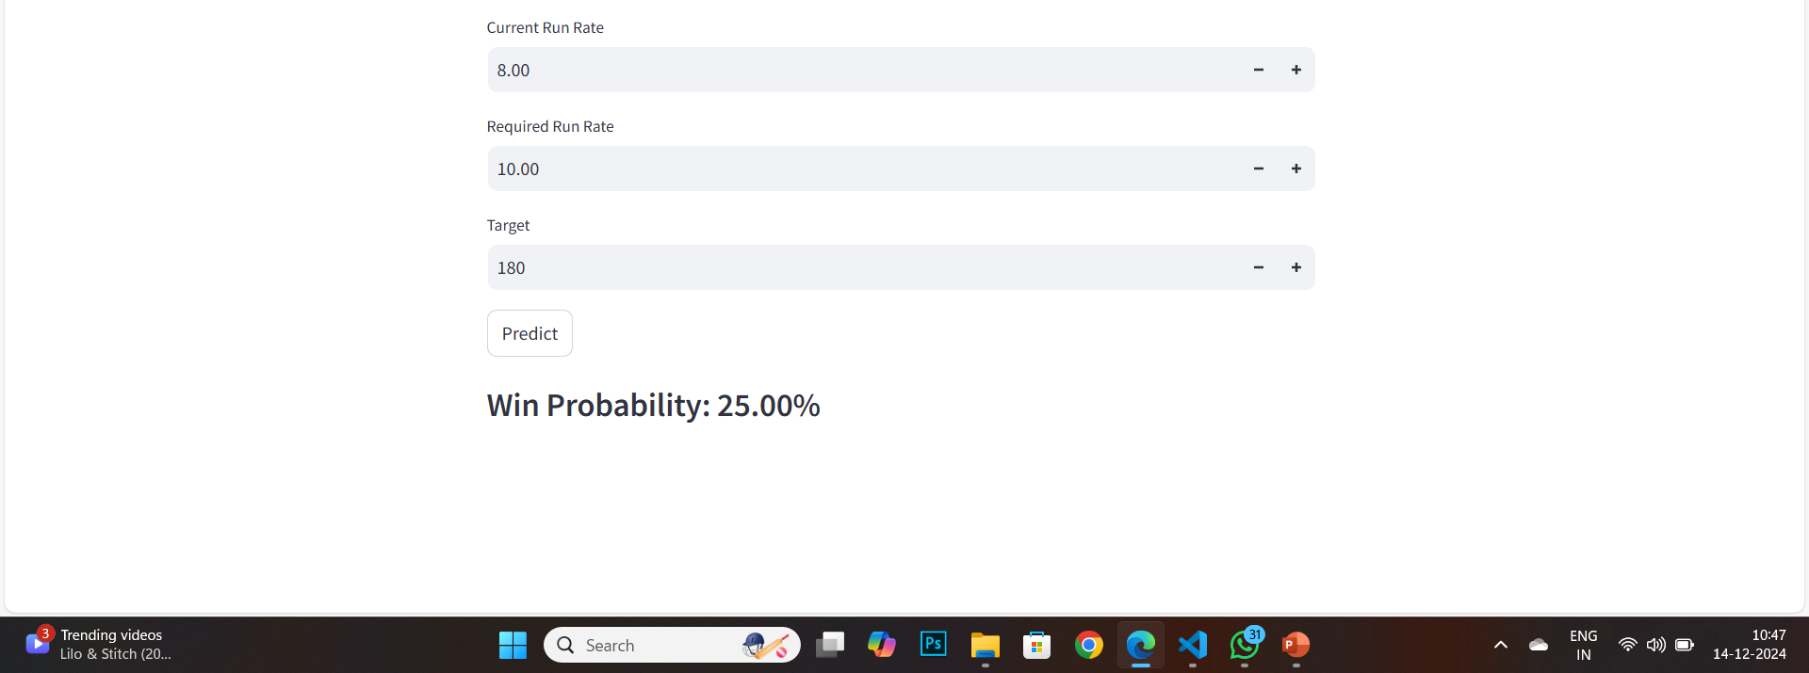

Slide 29

Atlantis Highlights in Computer Sciences, volume 4
Proceedings of the 3rd International Conference on Integrated Intelligent Computing Communication & Security (ICIIC 2021)
Prediction of IPL Match Outcome Using Machine Learning Techniques
Srikantaiah K C^{1,*}, Aryan Khetan¹, Baibhav Kumar¹, Divy Tolani¹, Harshal Patel¹
¹Department of CSE, SJB Institute of Technology, Affilated to Visveswaraya Technological University BGS Health & Education City, Bengaluru-560060, Karnataka, India
*Corresponding author. Email: srikantaiahkc@gmail.com,
ABSTRACT
India's most popular sport is cricket and is played across all over the nation in different formats like T20, ODI, and Test. The Indian Premier League (IPL) is a national cricketmatch where players are drawn from regional teams of India,
National Team and also from international team. Many factors like live streaming, radio, TV broadcast made this league as popular among cricket fans. The prediction of the outcome of the IPL matches is very important for online traders and sponsors. We can predict the match between two teams based on various factors like team composition, batting and
bowling averages of each player in the team, and the team's success in their previous matches, in addition to traditional factors such as toss, venue, and day-night, the probability of winning by batting first at a specified match venue against a specific team. In this paper, we have proposed a model for predicting outcome of the IPL matches using Machine
learning Algorithms namely SVM, Random Forest Classifier (RFC), Logistic Regression and K-Nearest Neighbor. Experimental results showed that the Random Forest algorithm outperforms other algorithms with an accuracy of 88.10%.
Keywords: Cricket, Indian Premier League, Logistic Regression, Machine Learning, Prediction of match outcome, Random Forest Classifier.
1. INTRODUCTION
Cricket is an outdoor game which is played by bat and bowl which includes 2 teams of 11 players each. Cricket is a teamwork game and is played mostly in three formats and occupies the 2 spots in the list of the most popular sport around the World. Like in any sport, there are many factors that plays an importantrole in deciding the winner of the match. Selection of a team is based on the player performance and other considerations like pitch factor, team size, venue etc. There are many variables and constraints which makes The Analysis of Cricket Match Difficult. There are three different formats of Cricket namely - Tests, Twenty-twenty (T20) and One Day International (ODI). Cricket is not only a nation game but also an international game. In this game, every ball is crucial because every ball can change the whole match in Cricket [15, 16].
Indian Premier League (IPL) is a national cricketmatch where players are drawn from regional teams of India, National Team and also from international team. It is based on 20-20 format and is owned by Celebrities, Businessmen
and others and the entire IPL is controlled by Board of Control for Cricket in India (BCCI). For the current year (2021)there are total of 8 Teams in IPL namely, Royal Challengers Bangalore (RCB), Rajasthan Royals (RR), Chennai Super Kings (CSK), Mumbai Indians (MI), Kolkata Knight Riders (KKR), Delhi Capitals (DC), Punjab Kings (PK) and SunRisers Hyderabad (SRH). The motivation behind this paper includes the answers to following questions: “What is the probability of winning the game at a particular venue based on decision to field/bat first on winning the toss?”, “Most dismissals by a bowler in a match?”, “Does Home Ground have any effect on the result of the game?
In this paper We are trying to find out the match winner of an IPL match based on the stadium they are choosing and the toss decision using machine learning techniques like SVM, Random Forest, Logistic Regression etc. Remainder of the paper is organized as follows: The section 2 is the literature survey, section 3 deals with the problem definition and the architecture. Section 4 deals with the experimental results. Section 5 talks about the conclusion.
Copyright © 2021 The Authors. Published by Atlantis Press International B.V.
This is an open access article distributed under the CC BY-NC 4.0 license -http://creativecommons.org/licenses/by-nc/4.0/. 399

Slide 30
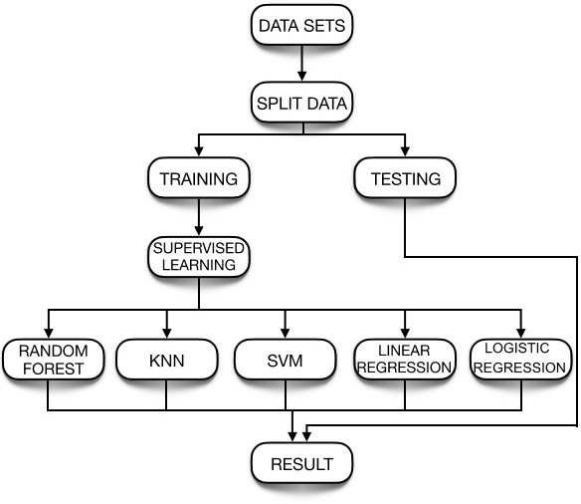
Atlantis Highlights in Computer Sciences, volume 4
2. LITERATURE SURVEY
Ahmad et al. [1], predicted the emerging players from batsman as well as from the bowlers using machine learning techniques. Song et al. [2] predicted estimation of the location of a moving ball based on the value of the cricket sensor network. Roy et al. [3] predicted ranking system which is based on the social network factors and their evaluation in the form of composite distributed framework using Hadoop framework and MapReduce programming model is used for processing the data. Priyanka et al. [4], predicted the outcome of IPL-2020 based on the 2008-2019 IPL datasets using Data Mining Algorithms with an accuracy of 82.73%.
Kansal et al. [5], predicted player evaluation in IPL based on the 2008-2019 datasets using Data Mining Technique. Data mining algorithms are used which gives evaluation using player statistics assessing a player's performance and determining his base price. They predicted about how to select a player in the IPL, based on every player’s performance history using algorithms like decision tree, Naïve Bayes and Multilayer perceptron (MLP). MLP outperforms better than other algorithms. Agrawal et al. [6], used Support Vector Machine (SVM), CTree, and Naïve Baiyes classifiers with accuracies of 95.96%, 97.97% and 98.98% respectively, to predict the probability of the winner of the matches. Barot et al. [7], predicted the match outcome based on the toss and venue.
Kaluarachchi et al. [8], predicted match outcome using home ground, time of the match, match type, winning the toss and then batting first by using Naïve Bayes classifier. Passi et al. [9], predicted the performance of players based on the runs and the number of wickets. Both the type of problems is treated as
machine learning techniques. The model gave an accuracy of 76%, 67%, and 96% for batsmen, bowlers, and all-rounders respectively by using Random Forest Algorithm. This model helped them to select the best players of the game and predict outcomes of the match [25-29].
3. PROBLEM DEFINITION AND ARCHITECTURE
3.1. Problem Definition
Given IPL datasets of past 9 years, the main objective of this paper is to predict the outcome of an IPL match between two teams based on the analysis of previously stored data using Machine Learning algorithms. The information will be analyzed and preprocessed. After preprocessing the data will be used to train different models in order to give the outcomes. We will analyze the various datasets and use key variables such as strike rate, bowler economy, etc. and feed it as input to an algorithm will help us get the probable outcome of a match [16-19].
3.2. Architecture
The figure 1 represents the architecture of the model which includes different components like datasets, split data, Training, Testing, Supervised Learning models and Result.
classification problems where the list of runs, and list of wickets are classified in different ranges based on machine learning algorithms. The Random Forest algorithm outperforms better than other algorithms. Nigel Rodrigues et al. [10], predicted the value of the traits of the batsmen and the bowlers in the current match. This would help in selecting the players for the upcoming matches by using past performances of a player against a specific opposition team by using Multiple Random Forest Regression.
Wright [11], predicted the possible fixture for a cricket match based on the various venue, teams, number of holidays between each match in a fair and efficient manner. A metaheuristic procedure is used to progress from the basic solution to a complex final solution by a technique, Subcost-Guided Simulated Annealing (SGSA). Maduranga et al. [12], predicted the outcome of any cricket match by using data mining algorithms and provided solutions for the approach used by other
Figure 1 Architecture of the model
3.2.1. Dataset
The first step in the Architecture of model is to collect datasets from various sources. The data which is fed into the model decides how the model acts and reacts. If the data is accurate and up-to-date, then we will have accurate outcomes or predictions. So, we have collected 6 datasets from Kaggle.com which are as follows [20-21].
authors. Shetty et al. [13], predicted the capabilities of each player depending on various factors like the ground, pitch type, opposition team and several others by using

Slide 31
Atlantis Highlights in Computer Sciences, volume 4
3.2.1.1. Team wise home and away dataset
The Teamwise Home and Away dataset contains 6 columns for the datasets which are as follows: home_wins, away_wins, home_matches, away_matches, home_win_percentage and away_win_percentage. It describes about the team performance in the home and away conditions with their win percentage. The table 1 shows the dataset and its description [22].
Table 1. Teamwise Home and Away dataset description
 | the match was played.
Team 1 | Name of team who played match.
Team 2 | Name of team which played match.
Toss winner | Team that won the toss.
Toss decision | Decision of batting or fielding after winning toss.
Result | Outcome of match whether normal or tie.
Dl_applied | Information on whether DL method was applied or not.
Winner | Team that won the match.
Win by runs | The number of runs by which the team won.
Win by wickets | The number of wickets by which the team won.
Player of match | Name of player who was awarded player of the match.
Venue | Stadium in which match took place.
Umpire 1 | On field umpire name.
Umpire 2 | On field umpire name.
Column name | Column description
Home_wins | Tells the number of matches won by a team in their home ground.
away_wins | Tells the number of matches won by a team other than their home ground.
home_matches | Tells the number of matches played by a team in their home ground.
Away_matches | Tells the number of matches played by a team other than their home ground.
home_win_percentage | Percentage of matches won when played in home ground.
Away_win_percentage | Percentage of matches won when played in ground other than their home ground.
3.2.1.3. Player’s dataset
The Player’s dataset contains 5 columns namely Player_Name, DOB, Batting_Hand, Bowling_Skill and Country. This dataset tells about the player and his bowling and batting style. The table 3 shows the dataset column and its description.
Table 3. Player’s dataset description
3.2.1.2. Matches dataset
The Matches datasets contains 16 columns i.e season, city, date, team1, team2, toss_winer, toss_decision, result, dl_applied, winer, win_by_runs, win_by_matches and player_of_the_match, venue, umpire1 and umpire2. This dataset tells about the matches that are played between two teams and who was the winner of the match. It also tells about the toss decision taken in the match. The table 2 shows the dataset column and its description [23].
Table 2. Matches dataset description
Column name | Column description
Player Name | Name of the players
DOB | Date of birth of the players
Batting Hand | Tells whether the players are left-handed or right-handed.
Bowling skill | Bowling style of players
Country | Name of countries to which the player belongs.
Column name | Column description
Season | This column tells the season in which the match was played.
City | The city in which the match was played.
Date | The date on which

Slide 32
Atlantis Highlights in Computer Sciences, volume 4
3.2.1.4. Teams Datasets
The teams’ datasets contain a single column named as team1 which shows the various IPL teams. The table 4 shows the dataset column and its description.
Table 4. Teams dataset description
3.2.1.6. Most_runs_average_strikerate dataset
player_dismissed | If the player was given out or not
dismissal_kind | What kind of dismissal it was
Fielder | Player who caused dismissal
Column Name | Column Description
Team | Names of teams participating in the IPL tournament.
The Most_runs_average_strikerate dataset contains 6 columns namely batsman, total_runs, out, numberofballs, average, strikerate. This tells about player batting statistics. The table 6 shows the dataset column and its description.
Table 6. Most_runs_average_strikerate dataset description
3.2.1.5. Deliveries dataset
The Deliveries dataset contains 20 columns i.e innings, batting_team, bowling_team, over, Ball, Batsmen, Non_striker, Bowler, is_super_over, wide run, bye_run, Legbye_run, no_ball_run, penalty_run, batsmen_run, extra_runs, total_runs, players_dismissed,
dismissal_kind, fielder. The table 5 shows the dataset column and its description [24].
Table 5. Deliveries dataset description
Column name | Column description
Batsman | Name of the batsman.
Total_runs | Total runs scored by the batsman
Out | Tells about the number of times the batsman got out in the entire IPL career.
No_of_balls | Number of balls faced by the batsman overall.
Average | The average runs of the batsman
Strikerate | Tells us about the strike rate of the batsman.
Column Name | Column Description
Inning | Tells us the inning being played
Batting_team | Tells us name of then batting team
Bowling_team | Tells name of bowling team
Over | Tells the over number being bowled
Ball | Tells the ball number of the over
Batsmen | Name of batsmen on strike
Non-striker | Name of batsmen on runner end
Bowler | Name of bowler bowling
Is_super_over | Tells if over is super over or not
wide_run | If there are runs given for wide ball
bye_run | If there are any bye runs given
Legbye_run | If there are any leggy runs given
no_ball_run | If the ball was a no ball
penalty_run | Penalty runs due to any reason
batsmen_runs | Runs hit by batsmen on the ball
extra_runs | Total extra runs given
total_runs | Total runs in the ball
Split Data
In this step the dataset is splitted into two groups, one for testing and one for training. The training data is used to train the Machine learning algorithms using supervised learning techniques. The trained model is then tested using the algorithms and the result is predicted. The testing data and training data are divided in the ratio 30:70.
Training the model
Training is the most important stage in Machine Learning. In this step the model is trained using training data to find patterns and make predictions. It results in the model learning from the dataset so that it can accomplish the given task.
Testing the model
After training the model, the performance of the model is checked. This is done by testing the model with previously unseen datasets. The unseen Datasets is called

Slide 33
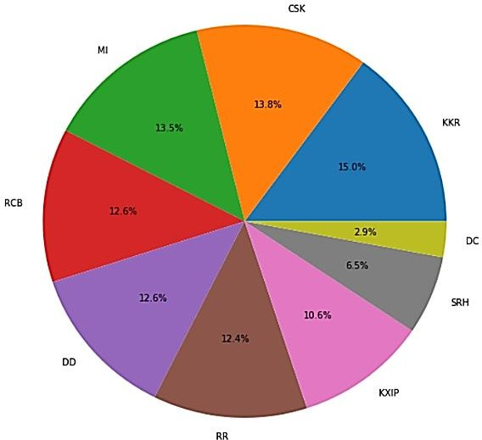
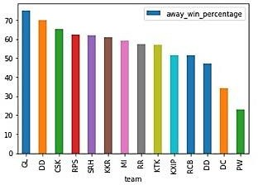
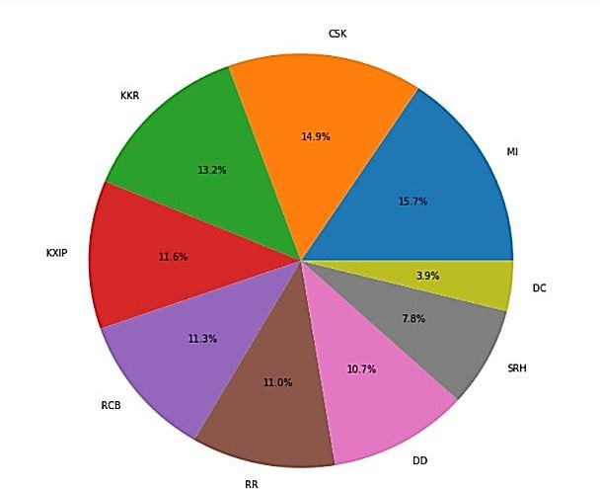
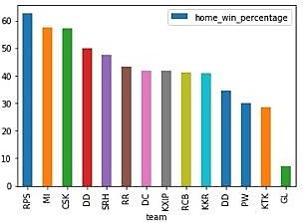
Atlantis Highlights in Computer Sciences, volume 4
the testing datasets. So, in this step the model is tested by providing the unseen testing data.
3.2.5. Supervised Learning
There are different types of Supervised Machine Learning Techniques like Logistic Regression, Support Vector Machine, K-Nearest Neighbor, Random Forest classifier, linear Regression etc.
EXPERIMENTAL RESULTS
Experimental Setup
The Experiments were carried out on minimum Hardware requirements that include Processor of Intel Atom or Intel core i3, Disk space should be at least 1GB, Operating System must be windows 7 or later, macOS and Linux. The machine learning algorithm was implemented using Python 3.8 and Jupyter Notebook. The Datasets were downloaded from Kaggle.
Figure 3 Team winning percentage while bowling first
Away win percentage is also being displayed in figure 4 below. From the figure 4, it can be seen that GL has the highest away win percentage.
4.2. Analysis of IPL datasets
The IPL dataset was analyzed, and some features were extracted out such as team winning percentage while batting first and team winning percentage while bowling first which is shown in figure 2 and figure 3.
Figure 4 Teamwise winning percentage in away matches
Home win percentage is also being displayed in fig 5 below. From the fig 5, it can be seen that RPS has the highest home win percentage.
Figure 2 Team winning percentage while batting first
Figure 5 Teamwise winning percentage in home matches

Slide 34
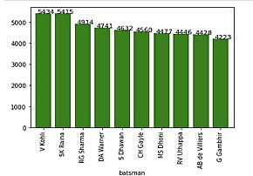
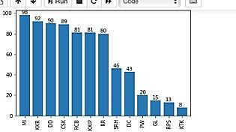
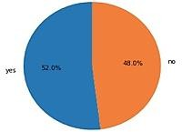
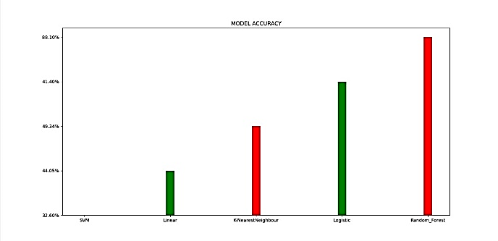
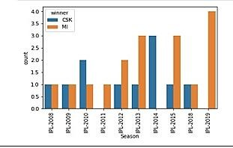
Atlantis Highlights in Computer Sciences, volume 4
The fig 6 gives the information about how many times a particular team has won the toss and a pie chart is made from the dataset information depicting the winning percentage of both batting first and batting second at a particular venue after winning the toss in fig 7.
Figure 9 Top run scorers
4.3. Performance Evaluation
1) Accuracy: The fraction of correct forecast in all predictions is known as accuracy. In this experiment, random forest classifier outruns all the
Figure 6 how many times a particular team won the toss
algorithms by predicting the result with highest accuracy of 88.10%. The figure 10 shows the accuracies of the various algorithms implemented.
Figure 10 Accuracy of various algorithms
Table 7 shows about the various algorithms and their accuracies obtained. It is clear from the table that the random forest classifier performed better than other algorithm.
Table 7. Accuracy achieved by the algorithms
Figure 7 Winning percentage after winning the toss
The comparison between the two particular teams playing the match is shown through graph which could help in predicting the winner. Comparison between MI and CSK over various seasons is shown over here through figure 8.
Algorithm | Accuracy
Random Forest | 88.10%
K-Nearest Neighbor | 49.34%
Logistic Regression | 51.40%
SVM | 32.6%
Linear Regression | 44.05%
Furthermore, 2-fold, 5-fold, 10-fold cross validation for rfc is also implemented for having better insights in table 8
Figure 8 Team Comparison
Figure 9 displays the highest run scorers of IPL. From the fig, it can be seen that Virat Kohli is the highest run scorer with 5434 runs.

Slide 35
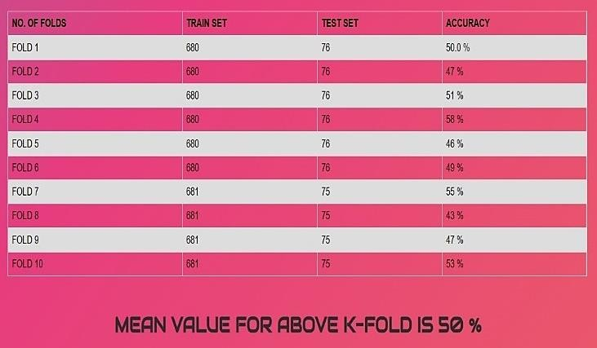
Atlantis Highlights in Computer Sciences, volume 4
Table 8. Cross validation Technique
Cricket Sensor Network, IEEE Transactions on Industrial Electronics, Volume: 59, Issue: 11,
November 2012.
Sarbani Roy, Paramita Dey and Debajyoti Kundu, Social Network Analysis of Cricket Community Using a Composite Distributed Framework: From Implementation Viewpoint, IEEE Transactions on Computational Social Systems, Volume: 5, Issue: 1, PP. 64-81, March 2018.
Priyanka S, Vysali K, K B PriyaIyer, Score Prediction of Indian Premier League- IPL 2020 using Data Mining Algorithms, International Journal for Research in Applied Science &
Engineering Technology (IJRASET), Volume 8, Issue II, PP. 790-795.
Prince Kansal, Pankaj Kumar, Himanshu Arya,
Aditya Methaila, Player valuation in Indian premier league auction using data mining
5. CONCLUSIONS
Predicting a winner in a sport such as cricket is especially challenging and involves very complex processes. But with the introduction of machine learning, this can be made much easier and simpler. In this paper, various factors have been identified that contribute to the results of the Indian Premier League matches. Factors that have a major impact on the outcome of an IPL match include the teams playing, the venue, the city, the toss winner and the toss decision. We have analyzed IPL data sets and predicted game results based on player performance. The methods used in the work to obtain the final test are Logistic regression, Support Vector Machine (SVM), Decision tree, Random Forest classifier and K-nearest neighborhood. Random Forest classification (RFC) outperforms the other algorithm.
technique, International Conference on
Contemporary Computing and Informatics (IC3I), 27-29 Nov 2014
[6] Shilpi Agrawal, Suraj Pal Singh, Jayash Kumar
Sharma, predicting results of IPL T-20 Match using Machine Learning, 2018 8th International Conference on Communication Systems and Network Technologies (CSNT), 24-26 Nov. 2018.
[7] Harshit Barot, Arya Kothari, Pramod Bide,
Bhavya Ahir, Romit Kankaria, Analysis and Prediction of Indian Premier League, 2020
International Conference for Emerging
Technology (INCET), 5-7 June 2020.
[8] Amal Kaluarachchi, S. Varde Aparna, CricAI: A classification-based tool to predict the
As for the scope of the future, the focus can be on each player’s performance and evaluate that on a regular basis for the season. His ratings for bowling and batting can also be predicted. There can be a chance to predict the man of the match for the two teams.
ACKNOWLEDGMENTS
We would like to express our sincere thanks to the Department of CSE, SJBIT for giving us a chance to work on this paper and our institution, SJB Institute of Technology for providing immense support throughout the paper. We would also like to extend our thanks to Visvesvaraya Technological University for providing us the opportunity to work on this paper.
outcome in ODI cricket, 2010 Fifth
International Conference on Information and
Automation for Sustainability, 17-19 Dec. 2010.
[9] Kalpdrum Passi and Nirav Kumar Pandey, predicting player’s performance in one day
international cricket matches using machine
learning, Volume 8, Computer Science & Information Technology, 2018.
[10] Nigel Rodrigues, Nelson Sequeira, Stephen Rodrigues, Varsha Shrivastava, Cricket Squad
Analysis Using Multiple Regression, IEEE Xplore, Conference on Advances Technology, 2019.
Random Forest 1st International in Information
REFERENCES
Haseeb Ahmad, Ali Daud, Licheng Wang, Haibo Hong, Hussain Dawood and Yixian Yang, Prediction of Rising Stars in the Game of Cricket, IEEE Access, Volume 5, PP. 4104 – 4124, 14
March 2017.
Haryong Song, Vladimir Shin and Moongu Jeon, Mobile Node Localization Using Fusion Prediction-Based Interacting Multiple Model in
[11] M. B. Wright, Scheduling fixtures for New Zealand Cricket, IMA Journal of Management Mathematics 16, PP. 99−112, 2005.
[12] Manuka Maduranga, Hatharasinghe,
Guhanathan Poravi, Data Mining and Machine
Learning in Cricket Match Outcome Prediction: Missing Links, 5th International Conference for Convergence in Technology (I2CT), Mar 29- 31, 2019.
[13] Monali Shetty, Sankalp Rane, Chaitanya Pandita, Suyash Salvi, Machine learning-based

Slide 36
Atlantis Highlights in Computer Sciences, volume 4
Selection of Optimal sports Team based on the Players Performance, Proceedings of the Fifth International Conference on Communication and Electronics Systems (ICCES 2020), IEEE Conference Record, ISBN: 978-1-7281-5371-1, 2020.
[14] Balasundaram A, Ashokkkumar S, Jayashree D, Magesh Kumar S, Data Mining based Classification of Players in Game of Cricket, proceedings of the International Conference on
sensing images." Remote Sensing 12, no. 24 (2020): 4135.
Puttamadappa, C., and B. D. Parameshachari. "Demand side management of small scale loads
in a smart grid using glow-worm swarm optimization technique." Microprocessors and Microsystems 71 (2019): 102886.
K. Yu, L. Tan, X. Shang, J. Huang, G. Srivastava
and P. Chatterjee, “Efficient and Privacy- Preserving Medical Research Support Platform
Smart Electronics and Communication
Against COVID-19: A Blockchain-Based
(ICOSEC 2020), IEEE Xplore Part Number: CFP20V90-ART; ISBN: 978-1-7281-5461-9.
Approach”, IEEE Consumer Electronics
[15] Jalaz Kumar, Rajeev Kumar, Pushpender
Magazine, doi: 10.1109/MCE.2020.3035520.
Kumar, Outcome Prediction of ODI Cricket Matches Using Decision Trees and MLP Networks, 2018 First International Conference
[25] K. Yu, M. Arifuzzaman, Z. Wen, D. Zhang and T. Sato, “A Key Management Scheme for Secure
Communications of Information Centric
on Secure Cyber Computing and
Advanced Metering Infrastructure in Smart Grid,” IEEE Transactions on Instrumentation and
Communication (ICSCCC).
Measurement, vol. 64, no. 8, pp. 2072-2085,
August 2015. https://ieeexplore.ieee.org/document/7138617
K. Yu, L. Lin, M. Alazab, L. Tan, B. Gu, “Deep
Learning-Based Traffic Safety Solution for a Mixture of Autonomous and Manual Vehicles in a 5G-Enabled Intelligent Transportation System”, IEEE Transactions on Intelligent Transportation Systems, doi: 10.1109/TITS.2020.3042504.
K. Yu, L. Tan, M. Aloqaily, H. Yang, and Y. Jararweh, “Blockchain-Enhanced Data Sharing with Traceable and Direct Revocation in IIoT”, IEEE Transactions on Industrial Informatics, doi: 10.1109/TII.2021.3049141.
Z．Guo, K. Yu, Y. Li, G. Srivastava, and J. C. -
W. Lin, “Deep Learning-Embedded Social Internet of Things for Ambiguity-Aware Social Recommendations”, IEEE Transactions on
[16] Prabu, S., Balamurugan Velan, F. V. Jayasudha,
P. Visu, and K. Janarthanan. "Mobile technologies for contact tracing and prevention of COVID-19 positive cases: a cross-sectional study." International Journal of Pervasive Computing and Communications (2020).
[17] Subramani, Prabu, K. Srinivas, R. Sujatha, and B.
D. Parameshachari. "Prediction of muscular paralysis disease based on hybrid feature extraction with machine learning technique for
COVID-19 and
patients." Personal and
post-COVID-19
Ubiquitous
Computing (2021): 1-14.
[18] Do, Dinh-Thuan, Tu Anh Le, Tu N. Nguyen, Xingwang Li, and Khaled M. Rabie. "Joint impacts of imperfect CSI and imperfect SIC in
cognitive radio-assisted NOMA-V2X
communications." IEEE Access 8 (2020):
128629-128645.
Network Science and Engineering, doi:
Le, Ngoc Tuyen, Jing-Wein Wang, Duc Huy Le, Chih-Chiang Wang, and Tu N. Nguyen. "Fingerprint enhancement based on tensor of wavelet subbands for classification." IEEE Access 8 (2020): 6602-6615.
Nguyen, Tu N., Bing-Hong Liu, Nam P. Nguyen, and Jung-Te Chou. "Cyber security of smart grid: attacks and defenses." In ICC 2020-2020 IEEE International Conference on Communications (ICC), pp. 1-6. IEEE, 2020.
Kumar, M. Keerthi, B. D. Parameshachari, S. Prabu, and Silvia liberata Ullo. "Comparative
Analysis to Identify Efficient Technique for Interfacing BCI System." In IOP Conference Series: Materials Science and Engineering, vol.
925, no. 1, p. 012062. IOP Publishing, 2020
Rajendran, Ganesh B., Uma M. Kumarasamy, Chiara Zarro, Parameshachari B. Divakarachari, and Silvia L. Ullo. "Land-use and land-cover classification using a human group-based particle swarm optimization algorithm with an LSTM Classifier on hybrid pre-processing remote-
10.1109/TNSE.2021.3049262.
[29] Z. Guo, A. K. Bashir, K. Yu, J. C. Lin, Y. Shen, “Graph Embedding-based Intelligent Industrial Decision for Complex Sewage Treatment Processes”, International Journal of Intelligent
Systems，2021, doi: 10.1002/int.22540.

